Slide 1
Loan Prediction Project
Colin Tran

Slide 2
AGENDA
Project Goal
Hypothesis
Model Prediction
Challenges

Slide 3
PROJECT GOAL
Utilize the given dataset to make a prediction on which individuals are more likely to have their loan approved

Slide 4
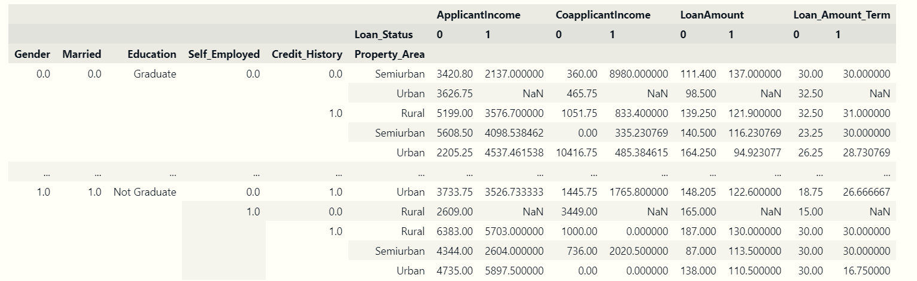
Which feature has the greatest impact on loan approval?

Slide 5
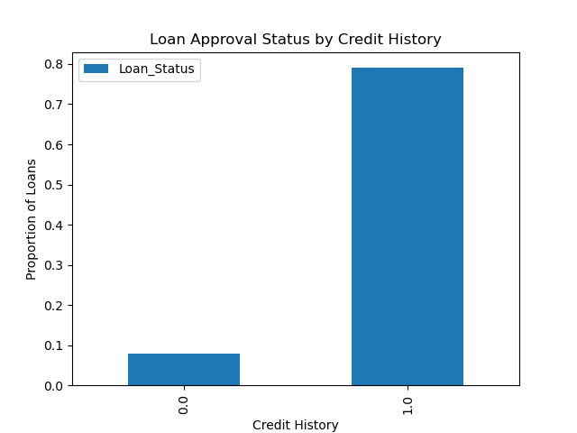
Loan approval by credit history

Slide 6
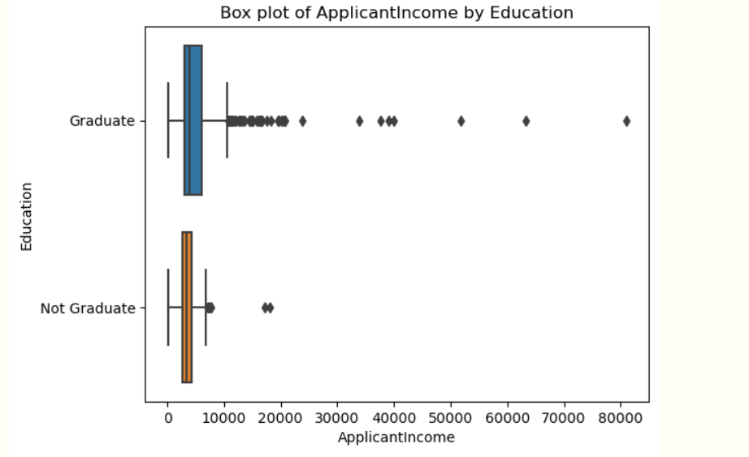
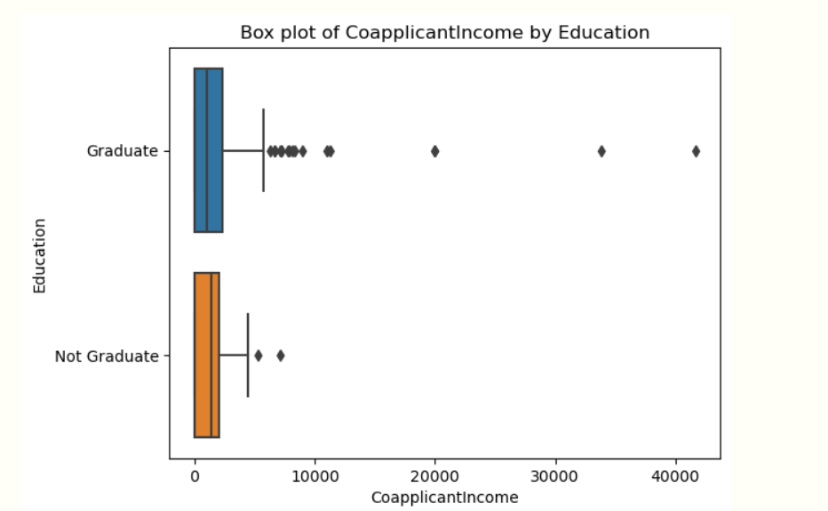
Income by education

Slide 7
Prediction model

Slide 8
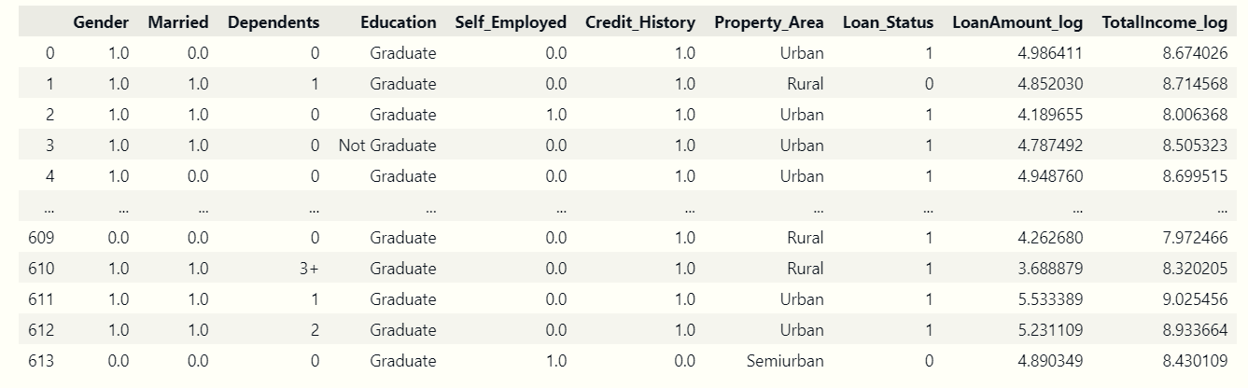
FEATURES FOR PREDICTION MODEL

Slide 9
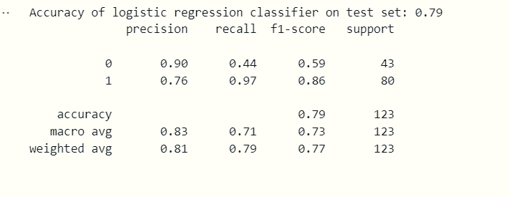

Logistic regression

Slide 10
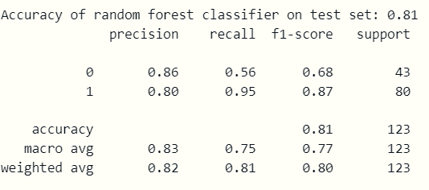
Random forest classification

Slide 11
challenge
A shortage of available time
In the process of learning how to utilize a pipeline and Flask application

Slide 12

Thank you for your listening

